Slide 1

Welcome to Year 3/4
2024-2025

Slide 2
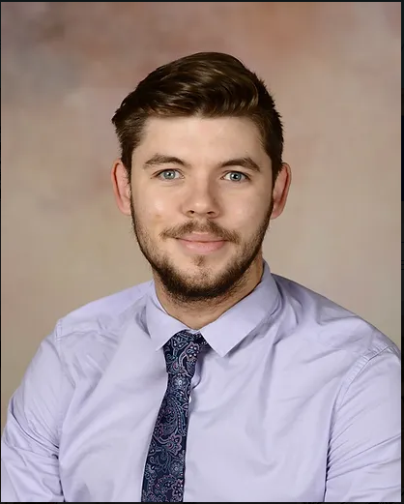
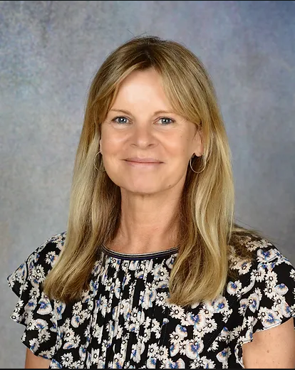
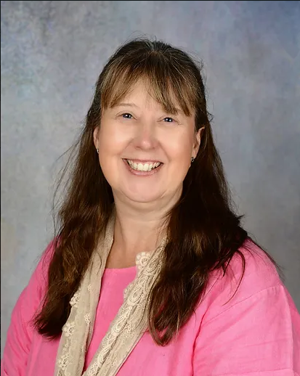
The Year 3/4 Team!
Kingfishers | Robins | Woodpeckers
Mr Wright | Ms Terry | Mrs Bone
LSAs Miss Burrows-Griffin, Mrs Burrows, Mrs Butler

Slide 3
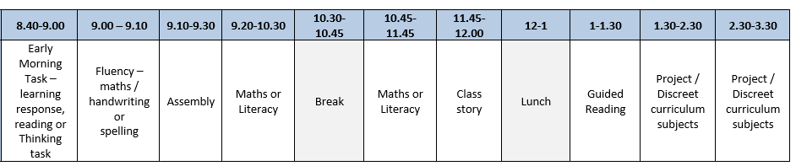
The School Week
A typical School Day:
PE Days – Monday and Wednesday
PPA time – Tuesday (Mr Wright and Ms Terry) Thursday (Mrs Bone)
Any other regular events:
Listen to me- To start in the summer term
Forest School- To be communicated with you soon.

Slide 4
Class Routines
Toilets
Water
Lockers
Equipment – pencil cases
Toys and personal belongings
Notes:
NB: Children are allowed to go the toilet – may be asked to wait until someone comes back so not going in groups. Encouraged to ask to go at an opportune moment. Always encouraged to go at break or lunch. If going too often parents will be contacted to check if there is a particular reason.
All children have access to water which can be refilled. Different classes have different organisation for this.
NO pencil cases in the classroom. Can be kept in lockers or in bags. Individual exceptions may be made to meet needs.
No toys or personal belongings to be brought into school as can’t guarantee safety! Occasional soft toy for comfort if arranged with the class teacher – these often ‘live’ in the class cupboard during the day.

Slide 5


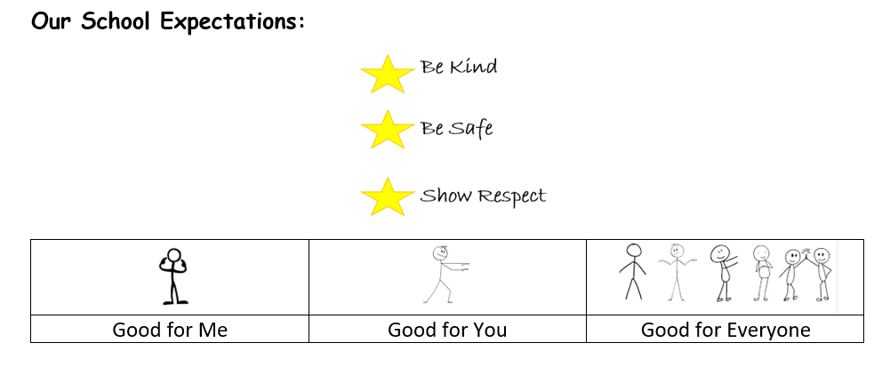
Notes:
Go through class’s ‘STARS values in Action’

Slide 6
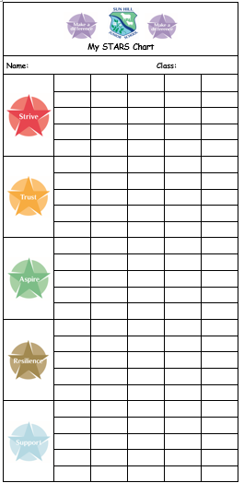
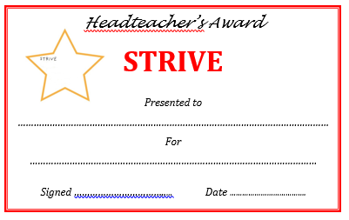

Rewards
Notes:
Go through certificates including that HT cert is one chosen by class and one by teacher.
Go through how stars are awarded – what for and how collected in communication books
A star = A housepoint
NB ALL staff can reward the children

Slide 7
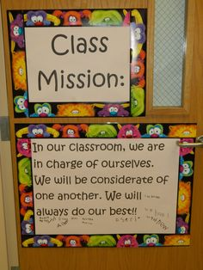
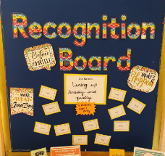

Setting Expectations
Notes:
Go through ethos of positive, calm, understanding approach to behaviour
A collective approach to behaviour supporting each other to a class environment where everyone can learn.

Slide 8
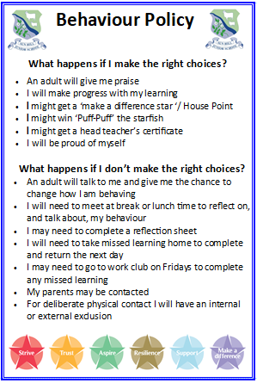
Behaviour Expectations
  The behaviour policy is currently under review to embrace the Empowerment Approach. This approach has the meeting of all children’s needs at its heart.
  There will be an information evening about this shortly.
Notes:
Let parents know that Mrs G is updating the behaviour policy and would welcome parent’s input on Friday 15th @ 2pm. Please let office know if they can attend.

Slide 9

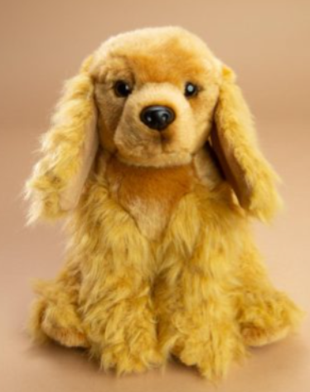
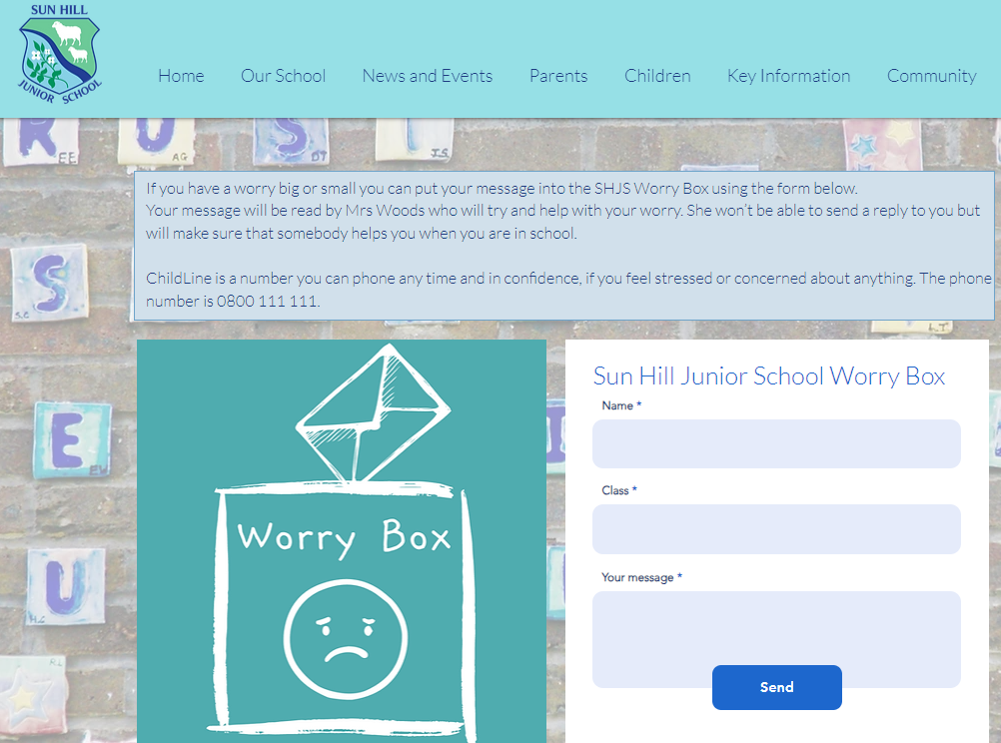
Wellbeing in School
Looking after the wellbeing of our school community is very important to us.
‘Bingo’ wellbeing award
https://www.sunhilljs.net/

Slide 10

Communication
Notes:
Central
Reading record
Recording focus 5 spellings and xtable test results
Stars
Any notes between home and school
Login details – TT rockstars etc

Slide 11
Communication
A strong home/school communication is vital
Please do contact us if you have any queries or concerns…
    Write a note in the home-school communication book. Teachers will also use this book to communicate to you. Please sign to show you have seen the note.
    Pass a message through the members of staff on morning duty
    Arrange a telephone appointment via the school office: 01962 732801
    All emails to class teachers to go via the office: adminoffice@sunhill-jun.hants.sch.uk We endeavour to answer emails within 48 hours
    The office needs notifications about absence – telephone: 01962 732801

Slide 12




Our Projects this year
The drivers for our curriculum:
CONFIDENCE
INITIATIVE
DIVERSITY
Autumn Term –History – Homes
Spring Term – Creative – Stories
Summer Term – Geography- Land of hope and glory.
Autumn “What makes a house a home?”
Notes:
Please adapt to your phase project
Talk a bit about this term’s project – the key question
Maybe some pictures?

Slide 13
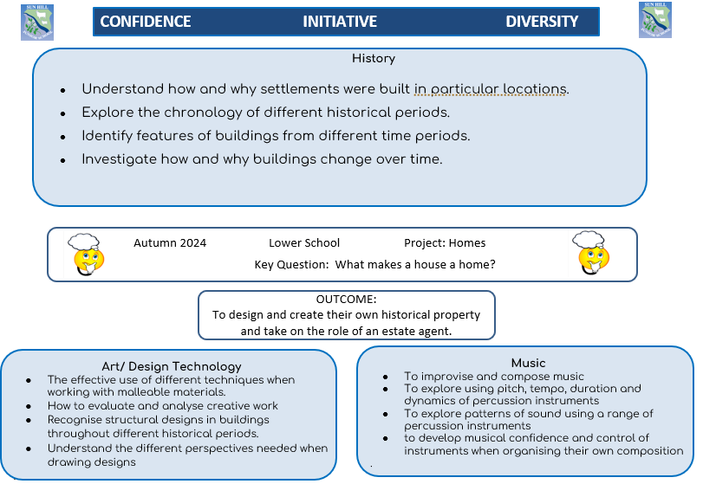

Slide 14
Trips and Visitors
Trips are currently being planned in line with projects
Year 3/4 trip to Butser Ancient Farm
Trip on the 15th October to visit Butser Ancient Farm in Clanfield, PO8 0BG.
We are still looking for parent volunteers. If you would like to volunteer, please talk to us or email a member of the office staff
Year 3/4 trip to Paltons Park
Official confirmation letter with date to be sent out later on this half term.
Notes:
Year 6 – add in details on the residential.
Other years + year 6 – include details on any planned trips or potential planned trips.

Slide 15
Assessment
An essential and integral part of the teaching and learning process
Formative Assessment
– continuous, ongoing assessment during classroom teaching and marking of daily learning
Summative Assessment
– assessment of individual learning – ‘tests’ (NFER). Beginning, middle and end of each year in maths and English.
- Part of normal learning journey and classroom practice. A way for children and adults to find out next steps.
Specific Learning Assessments
– used to assess and plan for how to meet specific learning needs.

Slide 16
Homework
Reading journals – to record reading 5x each week. New online library.
Spellings – individual ‘focus 5’ fortnightly in communication book
Times tables –Daily practice (TTRS) to prepare for weekly challenge in school.
Home learning research or project work

Slide 17
Spelling
We use The Spelling Book to teach spelling at Sun Hill. The system is built on strong phonic foundations and includes a range of deep exploratory investigations, alongside short-burst ‘chunked’ revision activities.
The Spelling Book is not a scheme, it’s a way of teaching spelling that relies on teachers to bring the ‘wonder of words’ to life.
The Spelling Book aims to:
1) provide structure and support to teachers whilst allowing enough room for creativity, ensuring that all National Curriculum fundamentals are covered.
2) exceed all expectations around making the teaching of spelling effective, and ‘stick-able', for children.
3) ensure that all concepts, activities and tasks taught increase ‘stickability’ and retention of vocabulary.

Slide 18
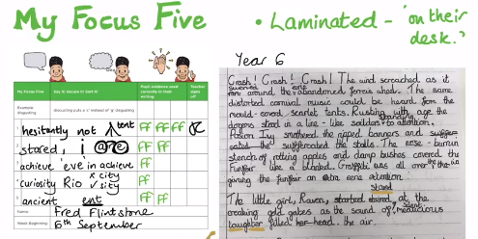
Spelling
In addition to being exposed to and exploring key vocabulary to enable children to cover the curriculum, the children will also have a Focus Five. The children will write their Focus Five in their reading records, so you can see what they’re focusing on.
These will be five words that your child finds tricky. They will identify the tricky part and aim to spell the word correctly within their writing at school. Once achieved, they change it for another tricky spelling.
The children will not
be tested on their
Focus Five, but encouraged
to use the words correctly
within their writing.
Differentiate approach
focusing on what your
child needs at that point.

Slide 19
Reading Books
Reading Books
‘Learn to Read’ and ‘Love to Read’ Books
Bug Club book at child’s reading level – books and quizzes available on line
Children are welcome to bring in age-appropriate books for independent reading
Book shelf in class to borrow from
‘Learn to Read’ books sent home for practise. To be returned please.
Library
Class visits to the Library every other week.
Children can have two books from the library
These could be reading age books or books they would like to take home and share with people at home
The children will all have a username and password for the ‘SORA’ system. This is an online library linked to Hampshire School Library Service. They can borrow a full range of reading material including books and magazines.
Notes:
Explain about Learn to read being reading level books e.g. bug club or Little Wandle and Love to Read for enjoyment, including books from the library.
Plea for volunteer readers and librarians

Slide 20
School Uniform and Equipment
ALL named
Long hair to be tied up – boys and girls
NO nail varnish, coloured hair dye or make-up
Single stud earrings which can be removed or covered for PE. Please provide surgical tape to cover earrings
A coat in school if any chance of rain
A hat and sun cream
Any mobile phones or smart watches handed-in during the school day

Slide 21
School Uniform and Equipment
As per on the website: https://www.sunhilljs.net/uniform
Any problems with uniform let us know; for example temporarily misplaced items or sensory needs.
Second hand uniform available in the front lobby
Notes:
Rather than going through the list of uniform, comment on how smart the children have been looking.

Slide 22
Reporting
Parents’ Evenings in autumn and spring (November, February)
Autumn Parents evening is 6th & 7th November. SEND Parents evening on the 16th October.
Spring Parents evening is 13th February and SEND 5th February.
A full written report in the Summer Term with an opportunity for a follow up meeting and ‘book look’ if required.

Slide 23
Helping in School
Listening to readers, playing maths games, helping in the library
Helping on school trips
Sharing experience
Indicate on sign-in sheet

Slide 24
Thank you for listening. If you have any further questions, please do come and find me afterwards.

